Slide 1
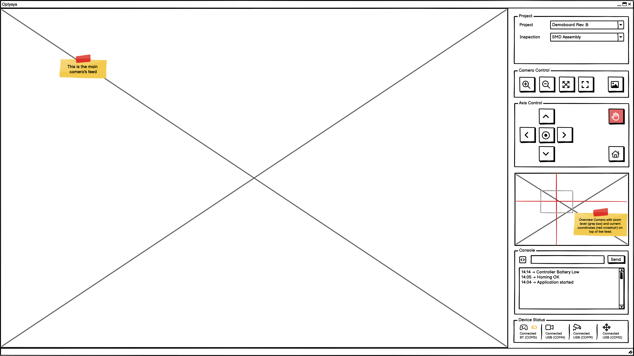

Slide 2

L2 Zoom- out
L1 Zoom out max
Auto-Focus
Toggle switch for Zoom and focus
R2 Zoom- in
R1 Zoom in MAX
Motor step X-Y
Centering
Take a pic
Safety stop
Motor Jog X-Y
Try: Homing with button
Mouse

